Slide 1


Introduction to Bayesian Inference and Decision Theory
STA 4030A - Bayesian Inference and Decision Theory

Slide 2
Bayesian Inference
Bayesian use probability to quantify rational degrees of belief.
Bayesian view inference as belief dynamics:
Use evidence to update prior beliefs to posterior beliefs
Posterior beliefs become prior beliefs for future evidence
Inference problems are usually embedded in decision problems.

Slide 3

Decision Theory
Decision theory is a formal theory of decision-making under uncertainty
A decision problem consists of:
Possible actions: ${\{a\}}_{a∈A}$.
States of the world (usually uncertain): ${\{s\}}_{s∈S}$.
Possible consequences: $\{{c\}}_{c∈A}$ depends on action and state
The best action maximizes expected utility.
$$a^{∗}=\underset{a}{argmax}{{\{𝔼}_{p\left(s\right)}\left[u\left(c\left(s,a\right)\right)|a\right]\}}$$

Slide 4
Illustrative Example: Highly Oversimplified Decision Problem
Should we treat the patient for a disease?
We suspect she may have disease but do not know
Without treatment the disease will lead to long illness
Treatment has unpleasant side effects

Slide 5

Illustrative Example: Highly Oversimplified Decision Problem
Decision Model
Actions: Treat $\left(a_{T}\right)$, Don’t Treat $\left(a_{N}\right)$ States: Sick $\left(s_{D}\right)$, Well $\left(s_{W}\right)$.
Consequences:
$c\left(s_{W},a_{T}\right)=c_{WS}$ (well shortly, side effects) $c\left(s_{D},a_{T}\right)=c_{DS}$ (disease for long time, side effects)
$c\left(s_{W},a_{N}\right)=c_{WN}$ (well shortly, no side effects) $c\left(s_{D},a_{N}\right)=c_{DN}$ (disease for long time, no side effects)
Probabilities: $P\left(s_{D}\right)$.= 0.30
Utilities: $u\left(c_{WN}\right)=100,u\left(c_{WS}\right)=90,u\left(c_{DN}\right)=0$.
Notes:
$$c\left(s_{D},a_{T}\right)=c\left(s_{W},a_{T}\right)=c_{WS}$$

Slide 6
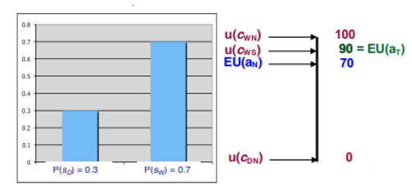

Illustrative Example: Highly Oversimplified Decision Problem
Expected Utility:
Treat: $\left(0.3×90\right)+\left(0.7×90\right)=90$.
Don’t treat: $\left(0.3×0\right)+\left(0.7×100\right)=70$.
Best action: Treat the patient $\left(a_{T}\right)$.

Slide 7
Decision Model Summary
Specify a decision problem by:
Possible actions.
Consequences.
States.
Probabilities of states.
Utilities for consequences.
Find the best decision by calculating the expected utility for each action and choose the one with the highest utility.
Sometimes we minimize expected loss (negative utility) instead of maximizing expected utility

Slide 8
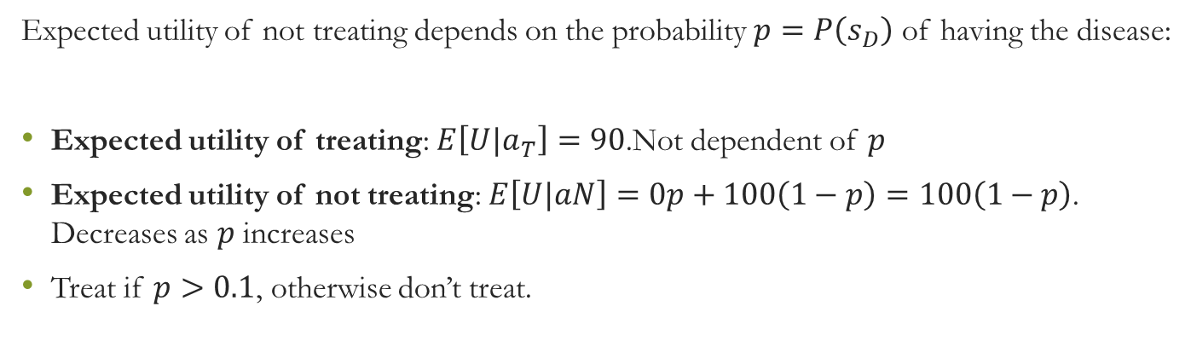
Sensitivity Analysis: How Optimal Decision Varies with Probability
Expected utility of not treating depends on the probability $p=P\left(s_{D}\right)$ of having the disease:
Expected utility of treating: $E\left[U|a_{T}\right]=90$.Not dependent of $p$
Expected utility of not treating: $E\left[U|aN\right]=0p+100\left(1−p\right)=100\left(1−p\right)$. Decreases as $p$ increases
Treat if $p>0.1$, otherwise don’t treat.

Slide 9

Bayes Rule: The Law of Belief Dynamics
Bayes Rule:
$$P\left(H_{i}|E\right)=\frac{P\left(E|H_{i}\right)P\left(H_{i}\right)}{P\left(E\right)}=\frac{P\left(E|H_{i}\right)P\left(H_{i}\right)}{\sum_{j}^{​}{P}\left(E|H_{j}\right)P\left(H_{j}\right)}$$
Odds likelihood form:
$$\frac{P\left(H_{i}|E\right)}{P\left(H_{j}|E\right)}=\frac{P\left(E|H_{i}\right)P\left(H_{i}\right)}{P\left(E|H_{j}\right)P\left(H_{j}\right)}$$
so long as $P\left(E\right)>0,P\left(H_{2}\right)>0$
The posterior probability of $H_{i}$ increases relative to $H_{j}$ if the evidence is more likely given $H_{i}$ than given $H_{j}$

Slide 10
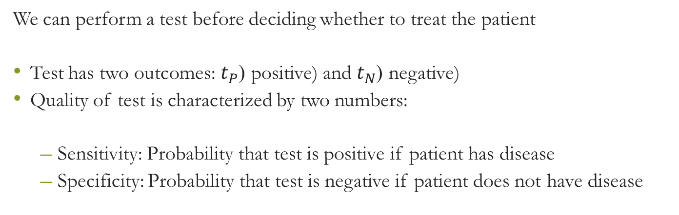
Example: Disease Problem with Test
We can perform a test before deciding whether to treat the patient
Test has two outcomes: $t_{P}$ (positive) and $t_{N}$ (negative)
Quality of test is characterized by two numbers:
Sensitivity: Probability that test is positive if patient has disease
Specificity: Probability that test is negative if patient does not have disease

Slide 11

Example: Disease Problem with Test
Test characteristics
Sensitivity: $P\left(t_{P} | s_{D}\right)=0.95$ Specificity: $P\left(t_{N} | s_{W}\right)= 0.85$
How does the model change if test results are available?
Take test, observe outcome $t$
Revise prior beliefs $P\left(s_{D}\right)$ to obtain posterior beliefs $P\left(s_{D}|t\right)$
Re-compute optimal decision using $P\left(s_{D}|t\right)$

Slide 12

Example: Disease Problem with Test
Review of Problem Ingredients:
$P\left(s_{D}\right)=0.3$ (prior probability of disease)
$P\left(t_{P}|s_{D}\right)=0.95$ and $P\left(t_{N}|s_{W}\right)=0.85$ (sensitivity & specificity of test)
$u\left(c_{WN}\right)=100,u\left(c_{WS}\right)=90;u\left(c_{DN}\right)=0$ (utilities)

Slide 13

Example: Disease Problem with Test
If positive test:
$$P\left(s_{D}|t_{P}\right)=\frac{P\left(t_{p}|s_{D}\right)P\left(s_{D}\right)}{P\left(t_{p}|s_{D}\right)P\left(s_{D}\right)+P\left(t_{p}|s_{W}\right)P\left(s_{W}\right)}=\frac{0.3×0.95}{0.3×0.95+0.7×0.15}=0.731$$
$$EU\left(a_{N}|t_{P}\right)=0.731×0+\left(1−0.731\right)×100=26.9$$
$$EU\left(a_{T}|t_{P}\right)=0.731×90+\left(1−0.731\right)×90=90$$
Best action: Treat.

Slide 14
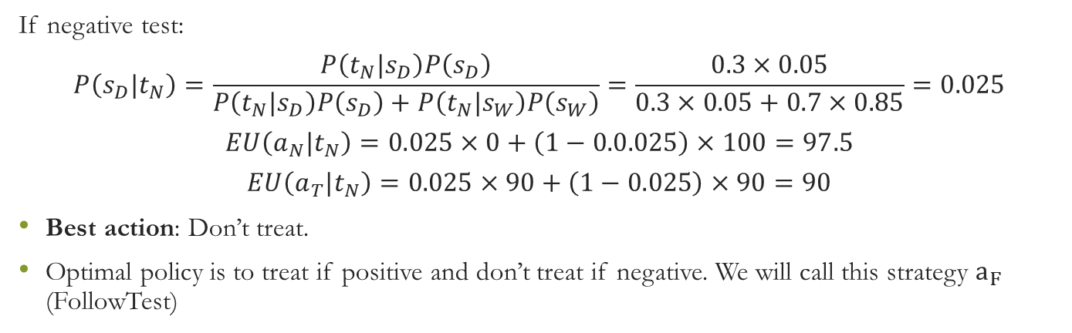
Example: Disease Problem with Test
If negative test:
$$P\left(s_{D}|t_{N}\right)=\frac{P\left(t_{N}|s_{D}\right)P\left(s_{D}\right)}{P\left(t_{N}|s_{D}\right)P\left(s_{D}\right)+P\left(t_{N}|s_{W}\right)P\left(s_{W}\right)}=\frac{0.3×0.05}{0.3×0.05+0.7×0.85}=0.025$$
$$EU\left(a_{N}|t_{N}\right)=0.025×0+\left(1−0.0.025\right)×100=97.5$$
$$EU\left(a_{T}|t_{N}\right)=0.025×90+\left(1−0.025\right)×90=90$$
Best action: Don’t treat.
Optimal policy is to treat if positive and don’t treat if negative. We will call this strategy $a_{F}$ (FollowTest)

Slide 15

Decision Tree for Disease Model with Test
To model a decision problem, we specify:
Possible actions [$a_{T},a_{N}$ in medical example]
Consequences [$c_{WN},c_{WS},c_{DN}$ in medical example]
States [$s_{D},s_{W}$ in medical example]
Probabilities of states depend on test outcome
$P\left(s_{D}|t_{N}\right)=0.025,P\left(s_{W}|t_{N}\right)$ = 0.975 with negative test
$P\left(s_{D}|t_{P}\right)=0.731,P\left(s_{W}|t_{P}\right)$ = 0.269 with positive test

Slide 16

Decision Tree for Disease Model with Test
Utilities for consequences [$u\left(c_{WN}\right)=100,u\left(c_{WS}\right)=90;u\left(c_{DN}\right)=0$ in medical example]
To find the best decision we calculate the expected utility for each action given the test result and choose the best
$E\left[u\left(a_{T}|t_{N}\right)\right]=90;E\left[u\left(a_{N}|t_{N}\right)\right]=97.5$; best decision is not to treat if test is negative
$E\left[u\left(a_{T}|t_{P}\right)\right]=90;E\left[u\left(a_{N}|t_{P}\right)\right]=26.9$; best decision is to treat if test is positive
We always make our decision based on the information we have at the time of the decision, so if a test result is available, we use the probability given the test result

Slide 17

Should We Gather Information?
Reminder of problem ingredients:
$P\left(s_{D}\right)=0.3$ (prior probability of disease)
$u\left(c_{WN}\right)=100,u\left(c_{WS}\right)=90;u\left(c_{DN}\right)=0$ (utilities)
$P\left(t_{P}|s_{D}\right)=0.95;P\left(t_{N}|s_{W}\right)=0.85$ (sensitivity & specificity of test)
Expected utility after doing test:
If test is positive, we should treat, with $EU\left(a_{T}\right)=EU\left(a_{T}|t_{P}\right)=90$
If test is negative, we should not treat, with $EU\left(a_{N}|t_{N}\right)=97.54098$

Slide 18

Should We Gather Information?
Probability test will be positive (use law of total probability):
$$P\left(t_{P}\right)=P\left(t_{P}|s_{D}\right)P\left(s_{D}\right)+P\left(t_{P}|s_{W}\right)P\left(s_{W}\right)=0.95×0.3+0.15×0.7=0.39$$
Expected utility of FollowTest strategy (treat if test is positive, otherwise not):
$$EU\left(a_{F}\right)=P\left(t_{P}\right)EU\left(a_{T}|t_{P}\right)+P\left(t_{N}\right)EU\left(a_{N}|t_{N}\right)$$
$$EU\left(a_{F}\right) =0.39×90+\left(1−0.39\right)×97.54098=94.6$$
$EU\left(a_{F}\right)$ is larger than $EU\left(a_{T}\right)=90$ so we should do the test

Slide 19
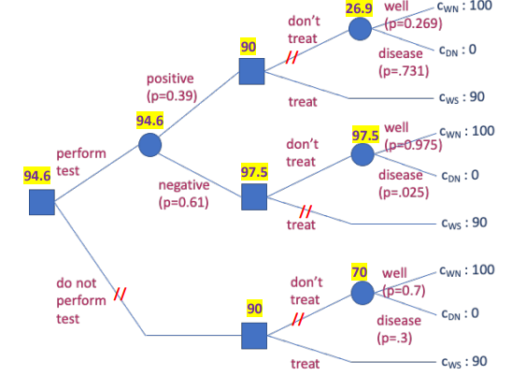
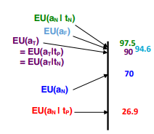
Decision Tree for Disease Model with Test

Slide 20

Expected Value of Information (EVSI, EVPI)
Expected Value of Sample Information (EVSI): Gain in expected utility from doing a test.
EVSI for our medical example is $94.6–90=4.6$
Expected Value of Perfect Information (EVPI): Gain in expected utility from perfect knowledge of an uncertain variable.

Slide 21

Expected Value of Information (EVSI, EVPI)
For medical example:
Suppose an oracle will tell us whether patient is sick (sensitivity = specificity = 1)
30% chance we discover she is sick and treat - utility 90
70% chance we discover she is well and don’t treat - utility 100
Expected utility if we ask the oracle $0.3×90+0.7×100=97$
Therefore $EVPI=97−90=7$
$$EVPI≥EVSI≥0$$
$EVSI=0$ if information won’t change your decision

Slide 22

Should We Collect Information?
General Principle: Free information can never hurt
Whether we should do the test depends on whether utility gain $EVSI=4.6$ is greater than cost of information
To analyze decision of whether to collect information:
Find maximum expected utility option if we don’t collect information
Compute its expected utility U0
Find EVPI and Compare EVPI with cost of information
If EVPI is too small in relation to cost then stop; otherwise, compute EVSI
Compare EVSI with cost of information
Collect information if expected utility gain is greater than cost of information

Slide 23
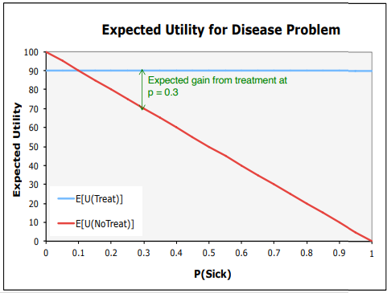

Strategy Regions for Medical Decision (Without Test)
Expected utility of not treating depends on the probability $p=P\left(s_{D}\right)$ of having the disease
$E\left[U|a_{T}\right]=90$
$E\left[U|a_{N}\right]=0p+100\left(1−p\right)=100\left(1–p\right)$
The strategy regions for the decision (without test):
$a_{T}$ if $p>0.1$
$a_{N}$ if $p<0.1$
What are the strategy regions if we do a test?

Slide 24
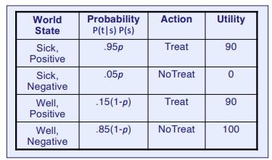


Expected Utility of FollowTest Policy as Function of Prior Probability $p=P\left(s_{D}\right)$
FollowTest strategy treats if test is positive and otherwise not
Before doing test, we think:
There are four possibilities for disease status and test results. Their probabilities are shown in the table
$$P\left(s,t\right)=P\left(t | s\right)P\left(s\right)=P\left(s | t\right)P\left(t\right)$$

Slide 25

Expected Utility of FollowTest Policy as Function of Prior Probability $p=P\left(s_{D}\right)$
We treat if test is positive and don’t treat if test is negative, with utilities shown in last column.
We multiply probability times utility for each world state and sum to get the expected utility of FollowTest
$$E\left[U | a_{F}\right]=\left(0.95p×90\right)+\left(0.05p×0\right)+\left(0.15\left(1−p\right)×90\right)+\left(0.85\left(1−p\right)×100\right)$$
$$E\left[U | a_{F}\right]=98.5–13p$$

Slide 26
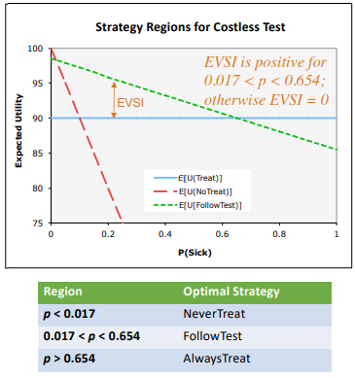

Strategy Regions for Medical Decision (With Test)
FollowTest: $EU\left(a_{F}\right)=98.5–13p$
AlwaysTreat: $EU\left(a_{T}\right)=90$. FollowTest is better when
$98.5–13p>90$ or $p<\frac{8.5}{13}=0.654$
NeverTreat: $EU\left(a_{N}\right)=100\left(1–p\right)$. FollowTest is better when
$98.5–13p>100\left(1−p\right)$ or $p>\frac{1.5}{87}=0.017$

Slide 27

Decision Model for Whether to Test: Summary
To model a decision problem, we specify:
Possible policies* [$a_{T},a_{N},a_{F}$ in medical example with test]
Consequences [$c_{WN},c_{WS},c_{DN}$ as previously]
States [$\left(s_{D},t_{P}\right),\left(s_{D},t_{N}\right),\left(s_{W},t_{P}\right),\left(s_{W},t_{N}\right)$, in medical example with test]

Slide 28

Decision Model for Whether to Test: Summary
To model a decision problem we specify:
Probabilities of states
$P\left(s_{D},t_{P}\right)=0.95p,P\left(s_{D},t_{N}\right)=0.05p,P\left(s_{W},t_{P}\right)=0.15\left(1−p\right),P\left(s_{W},t_{N}\right)=0.85\left(1−p\right)$
For $p=0.3,P\left(s_{D},t_{P}\right)=0.285,P\left(s_{D},t_{N}\right)=0.015,P\left(s_{W},t_{P}\right)=0.105,P\left(s_{W},t_{N}\right)=0.595$
Utilities for consequences [$u\left(c_{WN}\right)=100,u\left(c_{WS}\right)=90;u\left(c_{DN}\right)=0$ as previously]

Slide 29

Decision Model for Whether to Test: Summary
To find the best decision we calculate the expected utility for each policy
$E\left[u\left(a_{T}\right)\right]=90;E\left[u\left(a_{N}\right)\right]=100\left(1–p\right);E\left[u\left(a_{F}\right)\right]=98.5–13p$ in medical example with test
Best policy is $a_{T}$ if $p≤0.017$; $a_{F}$ if $0.017<p<0.654$; $a_{N}$ if $p>0.654$
For $p=0.3$, best policy is $a_{F}$

Slide 30
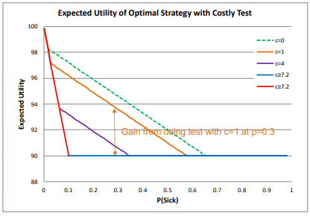

Strategy Regions for Costly Test:
FollowTest: $EU\left(a_{F}\right)=98.5–13p–c$
AlwaysTreat: $EU\left(a_{T}\right)=90$
FollowTest is better when
$98.5–13p–c>90$ or $p<\left(8.5−c\right)/13$
NeverTreat: $EU\left(a_{N}\right)=100\left(1–p\right)$
FollowTest is better when
$98.5–13p–c>100\left(1−p\right)$ or $p>\frac{\left(1.5+c\right)}{87}$
Test is worth doing if gain is larger than cost. Range of values for which test is worth doing: $\frac{\left(1.5+c\right)}{87}<p<\frac{\left(8.5−c\right)}{13}$
Notes:
(c is cost of test)

Slide 31
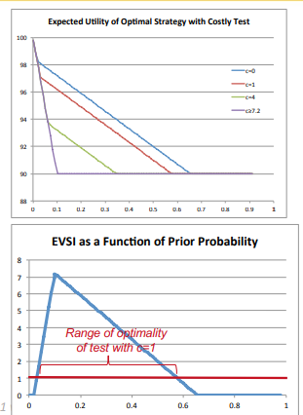

EVSI and Costly Test
Information collection is optimal when EVSI is greater than cost of test
Probability range where testing is optimal depends on cost of test
In our example for a test with cost c:
Testing is optimal if $\frac{\left(1.5+c\right)}{87}<p<\frac{\left(8.5−c\right)}{13}$

Slide 32
Summary : Value of Information and Strategy Regions
Collecting information may have value if it might change your decision
Expected value of perfect information (EVPI) is utility gain from knowing true value of uncertain variable
Expected value of sample information (EVSI) is utility gain from available information

Slide 33
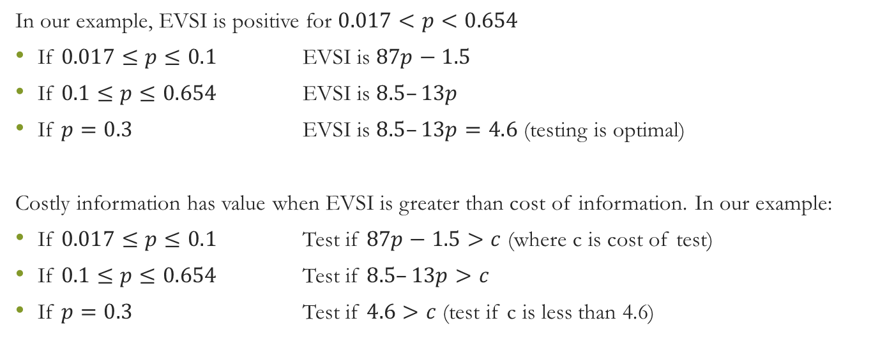
Summary : Value of Information and Strategy Regions
In our example, EVSI is positive for $0.017<p<0.654$
If $0.017≤p≤0.1$ EVSI is $87p−1.5$
If $0.1≤p≤0.654$ EVSI is $8.5–13p$
If $p=0.3$ EVSI is $8.5–13p=4.6$ (testing is optimal)
Costly information has value when EVSI is greater than cost of information. In our example:
If $0.017≤p≤0.1$ Test if $87p−1.5>c$ (where c is cost of test)
If $0.1≤p≤0.654$ Test if $8.5–13p>c$
If $p=0.3$ Test if $4.6>c$ (test if c is less than 4.6)

Slide 34
References
Bayes, Thomas. An essay towards solving a problem in the doctrine of chances. Philosophical Transactions of the Royal Society of London, 53:370-418, 1763.
Hoff, P. A First Course in Bayesian Statistical Methods. Springer, 2009.
Gelman, A., Carlin, J., Stern, H. and Rubin, D. Bayesian Data Analysis, 2nd ed., Chapman & Hall, 2004.
Savage, L.J. The Foundations of Statistics. Dover, 1972.

